Slide 1
ON-LINE
Spanish
Rigo Concept PSSE
Certificado Nivel Base
Curso Online Nivel Básico:
Conocimientos básicos en escoliosis y
otras deformidades vertebrales

Slide 2
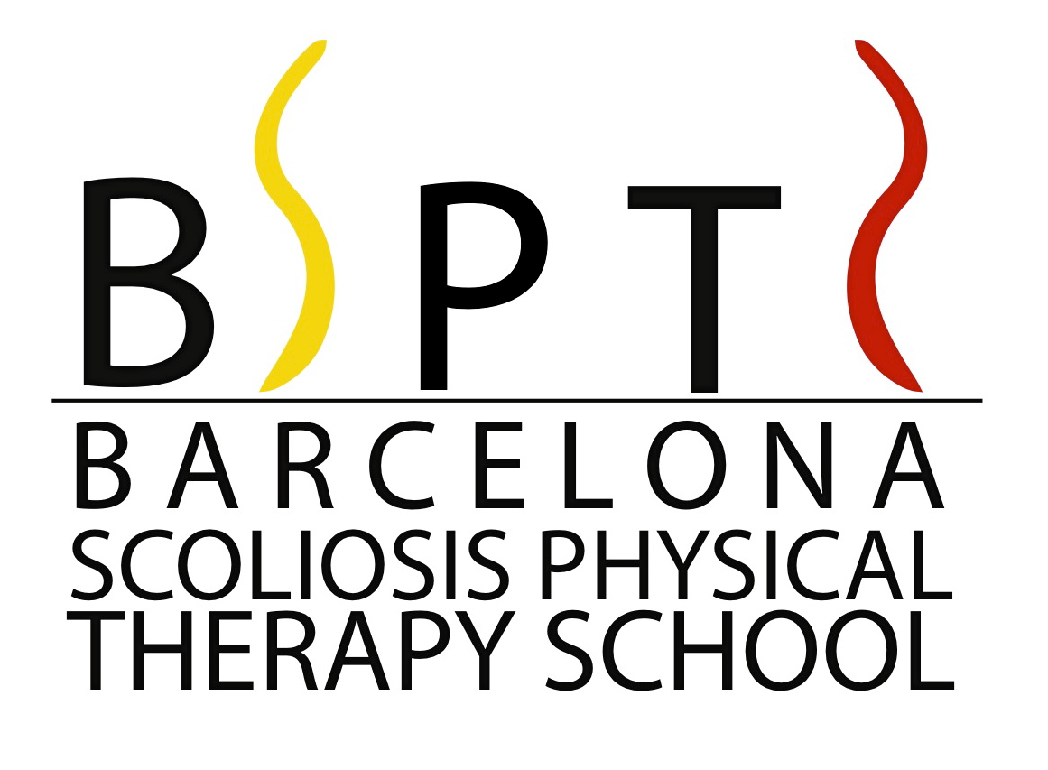
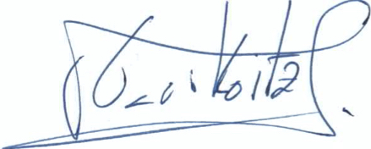
Rigo Concept PSSE
Certificado Nivel Base
Curso Online Nivel Básico:
Conocimientos básicos en escoliosis y
otras deformidades vertebrales
Chair: Manuel Rigo (Spain)
Co-Chair: Mina Jelacic (Serbia)
Teachers by Countries
Australia
Rebecca Harding
Larry Cohen
Bulgaria
Borislav Chongov
France
Sonia Martínez
Rebecca Sauvagnac
Greece
Nikos Karavidas
Israel
Iris Braz
Dror Levi
Lior Neuhaus-Sulam
Tamar Neuhaus
Liat Sadot
Poland
Mateus Kozinoga
Spain
Garikoitz Aristegui
Sonia Martínez
Nuria Puigdevall
Manuel Rigo
Mónica Villagrasa
Taiwan
Chin-Yen, Tseng
Yumin, Ding
The Netherlands
Marjan De Jonge
Ilse de Wilde-Kramer
Mariëtte Zoer
USA
Beth Janssen
Cindy Marti
Patti Orthwein
Amy Sbihli
Latino America
Garikoitz Aristegui
CERTIFICADO
Se certifica que:
Ha realizado y superado el examen del
Curso Online Nivel Básico de 24 horas lectivas:
Conocimientos básicos en escoliosis y
otras deformidades vertebrales
Este Certificado permite registrarse al Nivel 1 del Curso de Certificación de Ejercicios Específicos de Fisioterapia para la Escoliosis Rigo Concept.
El curso de Certificación consta de 4 niveles:
Nivel Base, Nivel 1, Nivel 2 y Nivel 3
Garikoitz Aristegui PT, OT PhD Dr. Manuel Rigo MD PhD
Chair of the On-line Base Level BSPTS Founder and Chair
Barcelona Scoliosis Physical Therapy School B67554741 Vía Augusta 185, entresuelo D. 08021 Barcelona, Spain www.bspts.net < monica@bspts.net gari @bspts.net>

Slide 3
ON-LINE
Portuguese
Rigo Concept PSSE
Certificado de Curso Base
Curso Nivel Base Online: Conhecimiento em Escoliose e outras deformidades da columna

Slide 4
Rigo Concept PSSE
Certificado de Curso Base
Curso Nivel Base Online: Conhecimiento em Escoliose e outras deformidades da columna
Chair: Manuel Rigo (Spain)
Co-Chair: Mina Jelacic (Serbia)
Teachers by Countries
Australia
Rebecca Harding
Larry Cohen
Bulgaria
Borislav Chongov
France
Sonia Martínez
Rebecca Sauvagnac
Greece
Nikos Karavidas
Israel
Iris Braz
Dror Levi
Lior Neuhaus-Sulam
Tamar Neuhaus
Liat Sadot
Poland
Mateus Kozinoga
Spain
Garikoitz Aristegui
Sonia Martínez
Nuria Puigdevall
Manuel Rigo
Mónica Villagrasa
Taiwan
Chin-Yen, Tseng
Yumin, Ding
The Netherlands
Marjan De Jonge
Ilse de Wilde-Kramer
Mariëtte Zoer
USA
Beth Janssen
Cindy Marti
Patti Orthwein
Amy Sbihli
Latino America
Garikoitz Aristegui
CERTIFICAÇÃO
Este certifica que:
Concluiu e passou no exame do
Curso Nivel Base Online:
Conhecimiento em Escoliose e outras deformidades da columna,
O Certificado de Conclusão do Nivel Base permite registrarse para o Nivel 1 do Curso Rigo Concept PSSE
O Diploma Final da Rigo Concept PSSE será ofrecido ao término da conclusão do Cursos: Nivel Base, Nivel 1, Nivel 2 e Nivel 3
Garikoitz Aristegui PT, OT, PhD Dr. Manuel Rigo MD PhD
Online Course Chair BSPTS Founder and Chair
Barcelona Scoliosis Physical Therapy School B67554741 Vía Augusta 185, entresuelo D. 08021 Barcelona, Spain www.bspts.net < monica@bspts.net gari @bspts.net>

Slide 5
ON-LINE
English
Rigo Concept PSSE
Base Course Certificate
Online Base Level Course: Knowledge on Scoliosis and other Spinal Disorders

Slide 6
Rigo Concept PSSE
Base Course Certificate
Online Base Level Course: Knowledge on Scoliosis and other Spinal Disorders
Chair: Manuel Rigo (Spain)
Co-Chair: Mina Jelacic (Serbia)
Teachers by Countries
Australia
Rebecca Harding
Larry Cohen
Bulgaria
Borislav Chongov
France
Sonia Martínez
Rebecca Sauvagnac
Greece
Nikos Karavidas
Israel
Iris Braz
Dror Levi
Lior Neuhaus-Sulam
Tamar Neuhaus
Liat Sadot
Poland
Mateus Kozinoga
Spain
Garikoitz Aristegui
Sonia Martínez
Nuria Puigdevall
Manuel Rigo
Mónica Villagrasa
Taiwan
Chin-Yen, Tseng
Yumin, Ding
The Netherlands
Marjan De Jonge
Ilse de Wilde-Kramer
Mariëtte Zoer
USA
Beth Janssen
Cindy Marti
Patti Orthwein
Amy Sbihli
Latino America
Garikoitz Aristegui
CERTIFICATION
This is to certify that:
Has been attending and passing the exam for
Online Basic Level Course:
Knowledge on Scoliosis and other Spinal Disorders,
This Base Level Certification allows Physiotherapist to register for the Rigo Concept PSSE Level 1 Course
Final Rigo Concept PSSE Certification will be offered at the end of the: Base Level, Level 1, Level 2 and Level 3
Garikoitz Aristegui PT, OT, PhD Dr. Manuel Rigo MD PhD
Online Course Chair BSPTS Founder and Chair
Barcelona Scoliosis Physical Therapy School B67554741 Vía Augusta 185, entresuelo D. 08021 Barcelona, Spain www.bspts.net < monica@bspts.net gari @bspts.net>

Slide 7
ON-LINE
French
Cours de certification
Rigo Concept PSSE
Cours en ligne niveau de base :
Connaissances de base en scoliose et d’autres difformités vertébrales

Slide 8
Cours de certification
Rigo Concept PSSE
Cours en ligne niveau de base :
Connaissances de base en scoliose et d’autres difformités vertébrales
Chair: Manuel Rigo (Spain)
Co-Chair: Mina Jelacic (Serbia)
Teachers by Countries
Australia
Rebecca Harding
Larry Cohen
Bulgaria
Borislav Chongov
France
Sonia Martínez
Rebecca Sauvagnac
Greece
Nikos Karavidas
Israel
Iris Braz
Dror Levi
Lior Neuhaus-Sulam
Tamar Neuhaus
Liat Sadot
Poland
Mateus Kozinoga
Spain
Garikoitz Aristegui
Sonia Martínez
Nuria Puigdevall
Manuel Rigo
Mónica Villagrasa
Taiwan
Chin-Yen, Tseng
Yumin, Ding
The Netherlands
Marjan De Jonge
Ilse de Wilde-Kramer
Mariëtte Zoer
USA
Beth Janssen
Cindy Marti
Patti Orthwein
Amy Sbihli
Latino America
Garikoitz Aristegui
CERTIFICAT
Il est reconnu que:
A approuvé le
Cours en ligne de niveau de base :
Connaissances de base en matière de scoliose et
autres difformités vertébrales
Ce certificat permet l'inscription au niveau 1 du cours de certification BSPTS-Concept by Rigo.
Le cours de certification comprend 4 niveaux :
Niveau de base, niveau 1, niveau 2 et niveau 3
A réalisé et approuvé l’examen
Garikoitz Aristegui PT, OT, PhD Dr. Manuel Rigo MD PhD
Director del Curso Online BSPTS Founder and Chair
Barcelona Scoliosis Physical Therapy School B67554741 Vía Augusta 185, entresuelo D. 08021 Barcelona, Spain www.bspts.net < monica@bspts.net gari@bspts.net>

Slide 9
FACE TO FACE
Rigo Concept PSSE
Base Course Certificate
Online Base Level Course: Knowledge on Scoliosis and other Spinal Disorders

Slide 10
Rigo Concept PSSE
Base Course Certificate
Base Level Course: Knowledge on Scoliosis and other Spinal Disorders
Chair: Manuel Rigo (Spain)
Co-Chair: Mina Jelacic (Serbia)
Teachers by Countries
Australia
Rebecca Harding
Larry Cohen
Bulgaria
Borislav Chongov
France
Sonia Martínez
Rebecca Sauvagnac
Greece
Nikos Karavidas
Israel
Iris Braz
Dror Levi
Lior Neuhaus-Sulam
Tamar Neuhaus
Liat Sadot
Poland
Mateus Kozinoga
Spain
Garikoitz Aristegui
Sonia Martínez
Nuria Puigdevall
Manuel Rigo
Mónica Villagrasa
Taiwan
Chin-Yen, Tseng
Yumin, Ding
The Netherlands
Marjan De Jonge
Ilse de Wilde-Kramer
Mariëtte Zoer
USA
Beth Janssen
Cindy Marti
Patti Orthwein
Amy Sbihli
Latino America
Garikoitz Aristegui
CERTIFICATION
This is to certify that:
STUDENT NAME
Has completed all required components and passed
the examination for the Base Level Course.
Total education and assessment hours involved is 24
in XXXXX from XX-XX September 2021
This Base Level Certification allows Physiotherapist to register for the Rigo Concept PSSE Level 1 Course
Final Rigo Concept PSSE Certification is awarded
Upon successful completion of the Base Level, Level 1,
Level 2 and Level 3 courses.
Date: 04/07/2021
Borislav Chongov Dr. Manuel Rigo MD PhD
Teacher of the Base Level BSPTS Founder and Chair
Barcelona Scoliosis Physical Therapy School B67554741 Vía Augusta 185, entresuelo D. 08021 Barcelona, Spain www.bspts.net < monica@bspts.net gari @bspts.net>

Slide 11
LEVEL 1
Spanish
Rigo Concept PSSE
Certificado Nivel 1
Nivel 1 Rigo Concept PSSE.
Principios de tratamiento, estrategias de corrección y posiciones básicas

Slide 12
Rigo Concept PSSE
Certificado Nivel 1
Nivel 1 Rigo Concept PSSE.
Principios de tratamiento, estrategias de corrección y posiciones básicas
Chair: Manuel Rigo (Spain)
Co-Chair: Mina Jelacic (Serbia)
Teachers by Countries
Australia
Rebecca Harding
Larry Cohen
Bulgaria
Borislav Chongov
France
Sonia Martínez
Rebecca Sauvagnac
Greece
Nikos Karavidas
Israel
Iris Braz
Dror Levi
Lior Neuhaus-Sulam
Tamar Neuhaus
Liat Sadot
Poland
Mateus Kozinoga
Spain
Garikoitz Aristegui
Sonia Martínez
Nuria Puigdevall
Manuel Rigo
Mónica Villagrasa
Taiwan
Chin-Yen, Tseng
Yumin, Ding
The Netherlands
Marjan De Jonge
Ilse de Wilde-Kramer
Mariëtte Zoer
USA
Beth Janssen
Cindy Marti
Patti Orthwein
Amy Sbihli
Latino America
Garikoitz Aristegui
CERTIFICADO
Se certifica que:
NOMBRE DEL ESTUDIANTE
Ha realizado y superado el examen escrito del
Curso Nivel 1 Rigo Concept PSSE.
El total de las horas de formación es de 48.
En Barcelona, del 17 al 22 de agosto del 2020
Este certificado del Nivel 1, permite al alumnos registrarse en el Curso Nivel 2 Rigo Concept PSSE.
La certificación final de la Rigo Concept PSSE se obtendrá una vez superados los cursos:
nivel base, nivel 1, nivel 2 y nivel 3.
Date: 22/08/2020
Nuria Puigdevall PT Dr. Manuel Rigo MD PhD
Director del Curso Nivel 1 Director y Fundador de la BSPTS
Barcelona Scoliosis Physical Therapy School B67554741 Vía Augusta 185, entresuelo D. 08021 Barcelona, Spain www.bspts.net < monica@bspts.net gari@bspts.net>

Slide 13
LEVEL 1
Rigo Concept PSSE
Level 1 Certificate
Level 1 Rigo Concept PSSE.
Treatment principles, correction strategies and basic positions

Slide 14
Rigo Concept PSSE
Level 1 Certificate
Level 1 Rigo Concept PSSE.
Treatment principles, correction strategies and basic positions
Chair: Manuel Rigo (Spain)
Co-Chair: Mina Jelacic (Serbia)
Teachers by Countries
Australia
Rebecca Harding
Larry Cohen
Bulgaria
Borislav Chongov
France
Sonia Martínez
Rebecca Sauvagnac
Greece
Nikos Karavidas
Israel
Iris Braz
Dror Levi
Lior Neuhaus-Sulam
Tamar Neuhaus
Liat Sadot
Poland
Mateus Kozinoga
Spain
Garikoitz Aristegui
Sonia Martínez
Nuria Puigdevall
Manuel Rigo
Mónica Villagrasa
Taiwan
Chin-Yen, Tseng
Yumin, Ding
The Netherlands
Marjan De Jonge
Ilse de Wilde-Kramer
Mariëtte Zoer
USA
Beth Janssen
Cindy Marti
Patti Orthwein
Amy Sbihli
Latino America
Garikoitz Aristegui
CERTIFICATION
This is to certify that:
STUDENT NAME
Has completed all required components and passed
the written examination for the Level 1 Course.
Total education and assessment hours involved is 48
in XXXXX from XX-XX January 2021
This Level 1 Certification allows Physiotherapist to register for the Rigo Concept Level 2 Course
Final Rigo Concept PSSE Certification is awarded
Upon successful completion of the Base Level, Level 1,
Level 2 and Level 3 courses.
Date: 01/01/2021
Cindy Marti Dr. Manuel Rigo MD PhD
Teacher of Level 1 BSPTS Founder and Chair
Barcelona Scoliosis Physical Therapy School B67554741 Vía Augusta 185, entresuelo D. 08021 Barcelona, Spain www.bspts.net < monica@bspts.net gari@bspts.net>

